Slide 1
Understanding the Vehicle CO2 emissions in Canada
Find out the correlation between vehicles and CO2 emissions during 7 years, and the solutions to improve environment in Canada
December 12, 2023

Slide 2
Table of contents
01
02
03
04
Introduction
Analysis
Conclusions & recommendations
Further exploration

Slide 3
01
Introduction

Slide 4
Problems
Solution:
Vehilce emit a large amount of CO2 that make the environment become worse in Canada.
Build the route to develop friendly – environmental vehicles to reduce the CO2 emission

Slide 5
02
Analysis

Slide 6
Analytical goal:
- WHY: The impact of vehicle on CO2 emissions
- HOW: Identify the specifications of an friendly-environment vehicle
Examine the vehicle factors affecting CO2 emissions
Share the overview impact of each vehicle class on CO2 emissions

Slide 7
Analytical goal:
- WHY: The impact of vehicle on CO2 emissions
- HOW: Identify the specifications of an friendly-environment vehicle
Examine the vehicle factors affecting CO2 emissions
Share the overview impact of each vehicle class on CO2 emissions

Slide 8
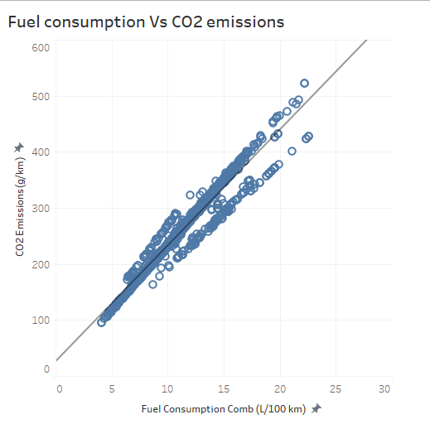
R = 0.92 positive correlation
- The more cars, the more fuel would be consumed.
- The more fuel consumption, the more CO2 emission.

Slide 9
Analytical goal:
- WHY: The impact of vehicle on CO2 emissions
- HOW: Identify the specifications of an friendly-environment vehicle
Examine the vehicle factors affecting CO2 emissions
Share the overview impact of each vehicle class on CO2 emissions

Slide 10
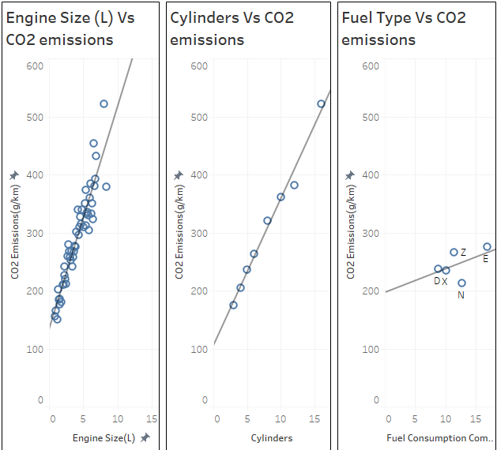
Which parts in vehicle affect CO2 emissions the most?
- The correlation between Engine Size and CO2 emission is the highest -> Engine size affects CO2 emissions the most.
➔ How engine size affects CO2 emissions in Canada?
R = 0.85
R = 0.83
R = 0.5

Slide 11
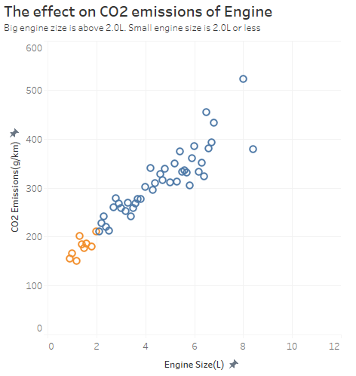
- Fact in Canada:
Car with big engine size is popular than small one (nearly 50% bigger).
- The bigger the car is, the more CO2 is emitted.

Slide 12
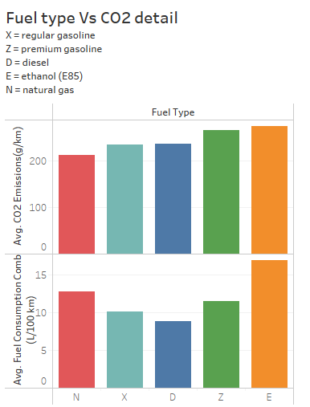
Which type of fuel is effective in saving environment?
- Natural gas emit the least CO2, but it's quite fuel consuming (the 2nd highest).
- Ethanol is the most ineffective fuel type.
→ To protect the environment, users will have to spend more money to regularly refill fuel.

Slide 13
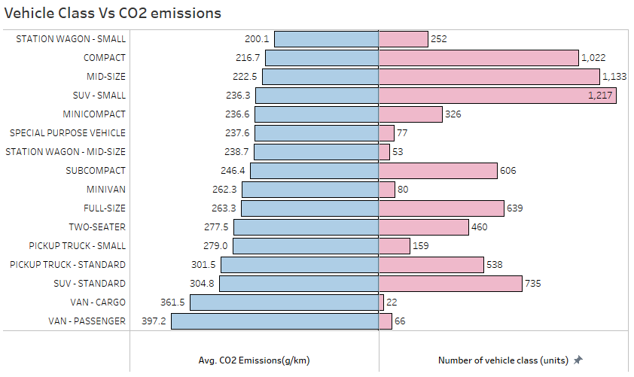
The impact of vehicle class on CO2 emissions
- Compact, Mid-size and SUV-Small are the most friendly-environmental vehicle class (Most used but emits little CO2)
- VAN (cargo, passenger) is the most harmful class to environment (Uses the least but emits the most CO2)

Slide 14
03
Conclusions & Recommendations

Slide 15
Conclusions
Analytical goal:
- WHY: The high levels of CO2 emissions from vehicles contribute significantly to climate change.
- HOW: + Reduce the amount of vehicles: reduce private vehicles, encourage public transportations.
+ Develop the Small engine size vehicle and small vehicle class.
+ Encourage vehicles using natural gas fuel type

Slide 16
04
Furthur exploration

Slide 17
Furthur exploration for developing friendly – environmental vehicles phase 2
- What is the impact of long driving distance vs. short
- What is the impact of transportation infrastructure on operating green vehicles?

Slide 18
Thank you.

